Slide 1
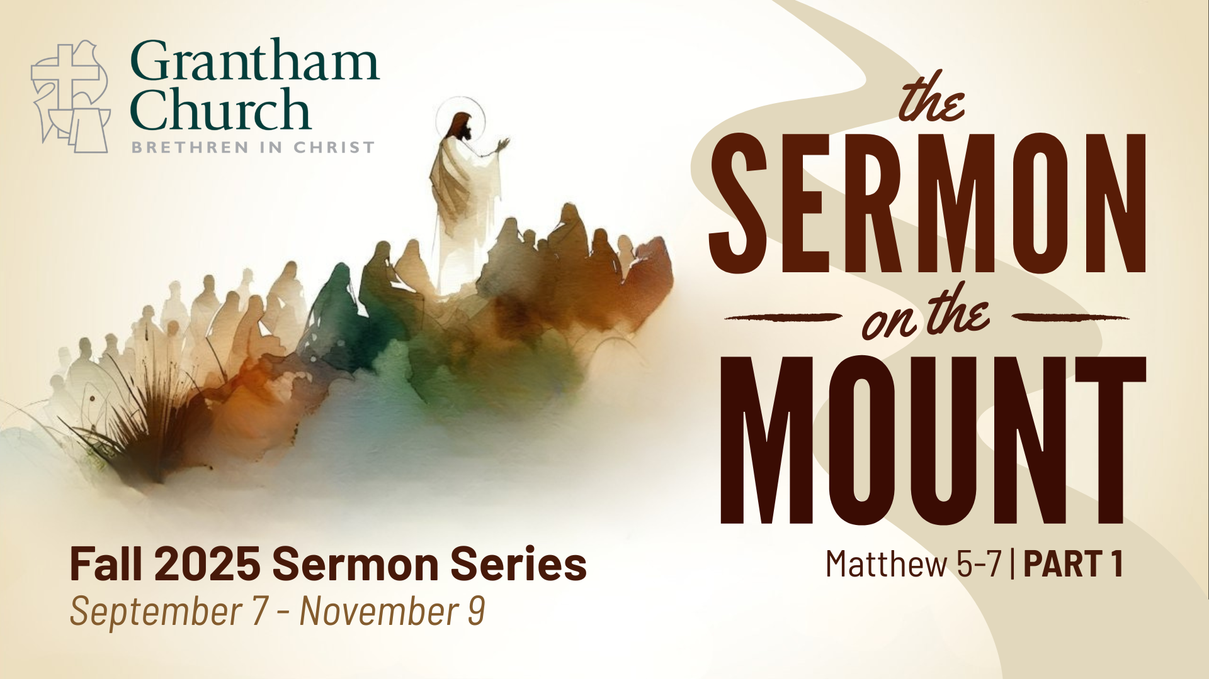
Notes:
[BRIEF INTRO]
Last week we began a new sermon series on the Sermon on the Mount, which is found in the Gospel of Matthew, chapters 5-7.
The Sermon on the Mount is the most… [NEXT SLIDE]

Slide 2
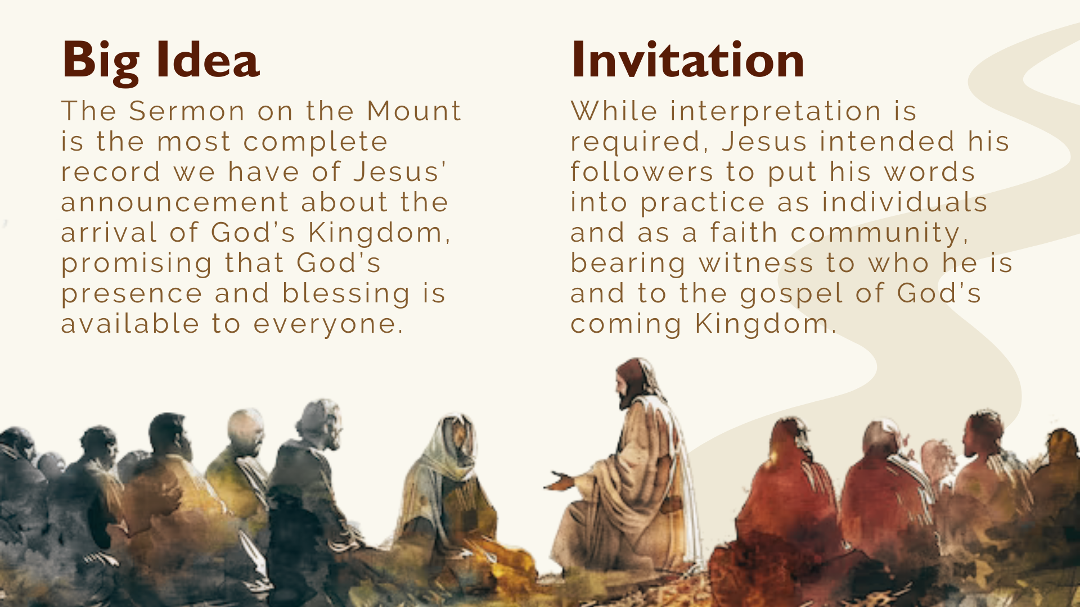
Notes:
complete record we have of Jesus’ announcement about the arrival of God’s Kingdom, promising that God’s presence and blessing is available to everyone. In the Sermon on the Mount, Jesus proclaims the gospel of the Kingdom and casts a vision of what it looks like to live in right relationship with God, our neighbors, and our enemies. These three chapters contain the core of Jesus’ teachings and his most well-known sayings, including some of the most rigorous ethical demands in the Bible.
And while interpretation and conversation are necessary, Jesus intended his followers to put his words into practice as individuals and as a faith community, bearing witness to who he is and to the gospel of God’s coming Kingdom. Therefore, what Jesus has given us in the Sermon on the Mount is not “pie in the sky when you die” for the sweet by-and-by. No, the teachings of Jesus and his invitation to follow him are for this world, as well as the next.
I pointed out last week that there is a 3-part structure to the Sermon on the Mount that’s helpful to notice as we begin… [NEXT SLIDE]

Slide 3
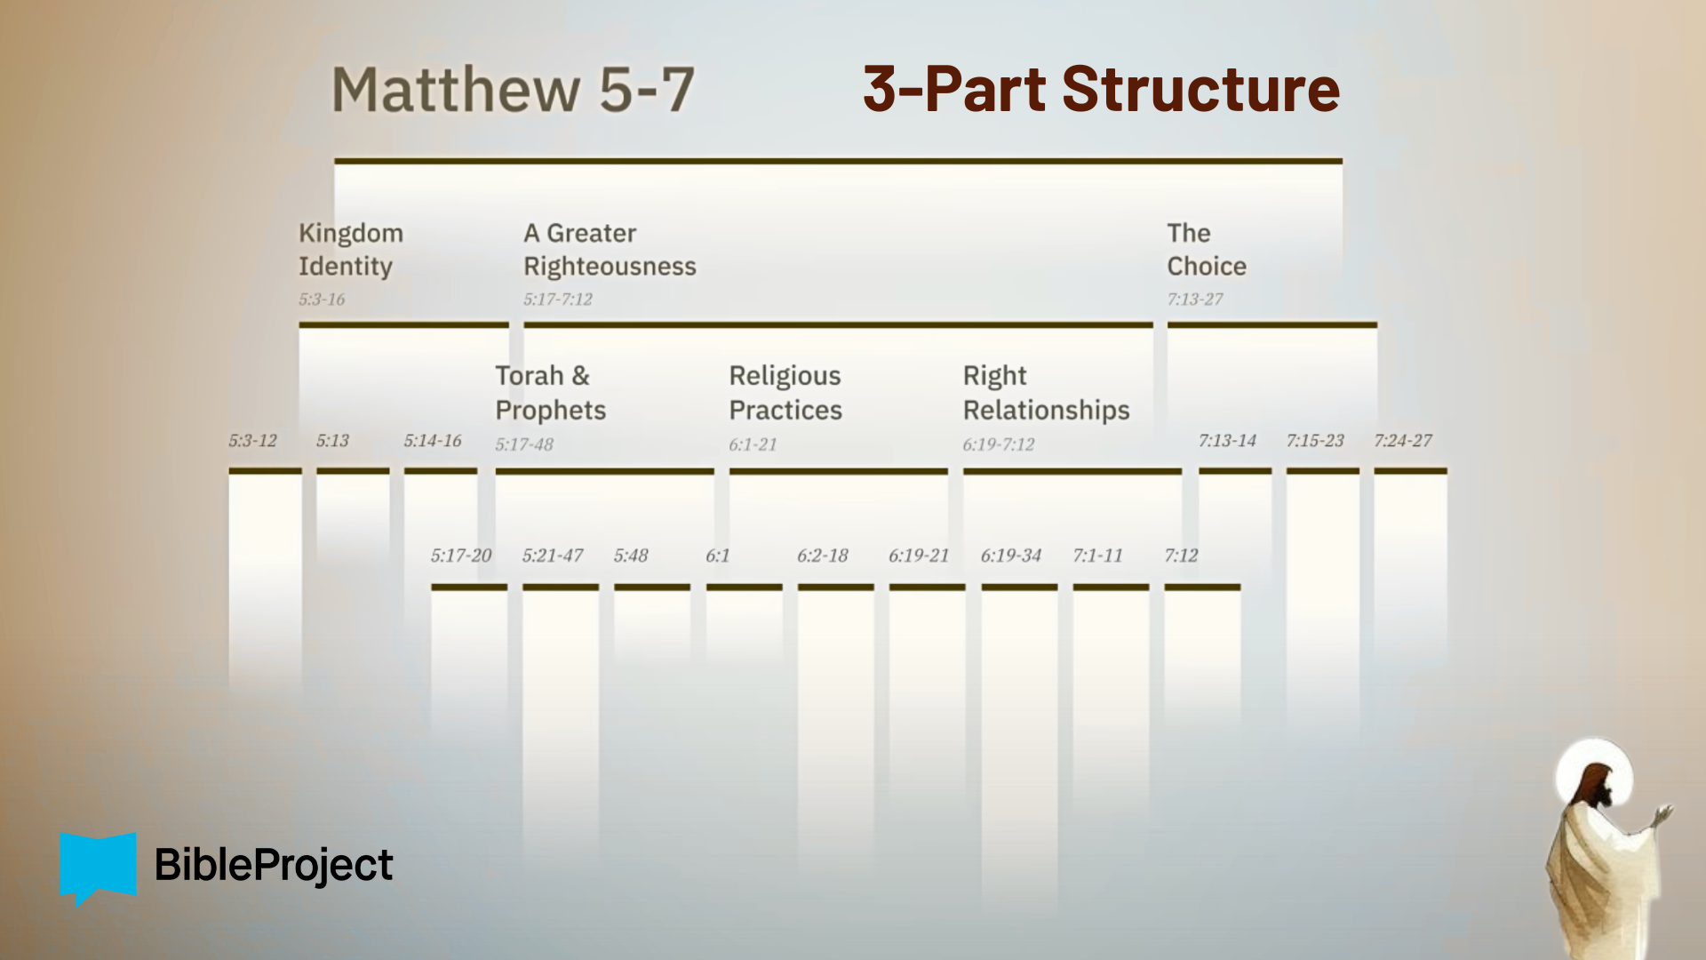
Notes:
The Sermon on the Mount contains 3 major sections, and the middle section (main body) itself has 3 parts, and each middle part breaks into 3 parts, as well.
First, there is an opening description of those who are being invited into his Kingdom and the sort of folks that God blesses, which we will look at today
Then the main body of the sermon, which describes what it looks like to live in right-relationship with God, our neighbors, and our enemies—A Greater Righteousness
And a conclusion that invites listeners to make a “choice” in how they will respond
Last week we began our series with the first two verses of the choice. In Matt. 7:13-14, Jesus said: “Enter through the narrow gate. For wide is the gate and broad is the road that leads to destruction, and many enter through it. But small is the gate and narrow the road that leads to life, and only a few find it.” We started with the end in mind so that we will continually keep before us the invitation to walk the narrow path of Jesus.
But first, in order to do that, Jesus said that we must repent… [NEXT SLIDE]

Slide 4
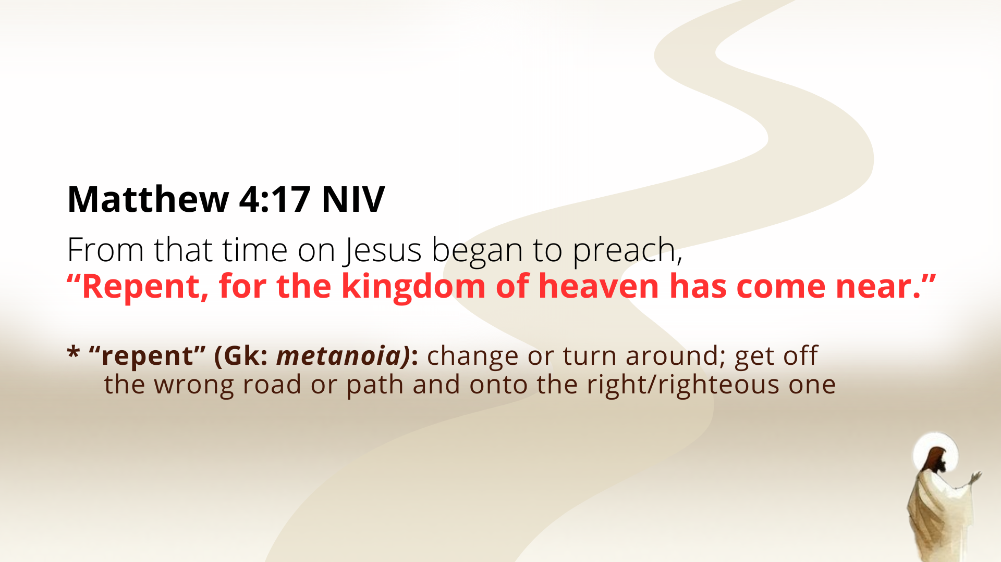
Notes:
In Matthew 4:17, leading up to the Sermon on the Mount in chapter 5, we’re told that after his temptations and being driven out of his hometown in Nazareth for claiming to be the promised Messiah, Jesus began to preach, “Repent, for the kingdom of heaven has come near.” And this call to “repent” is a call to change or turn around; to get off the wrong road or path and onto the one that leads to right relationships with God, neighbor, and enemies.
We can certainly hear this as a command, but it’s also an invitation; it’s an invitation to give up on our own way so that we could fully commit ourselves to the Jesus way.
And then a few verses later in chapter 4, look at what Matthew tells us… [NEXT SLIDE]

Slide 5
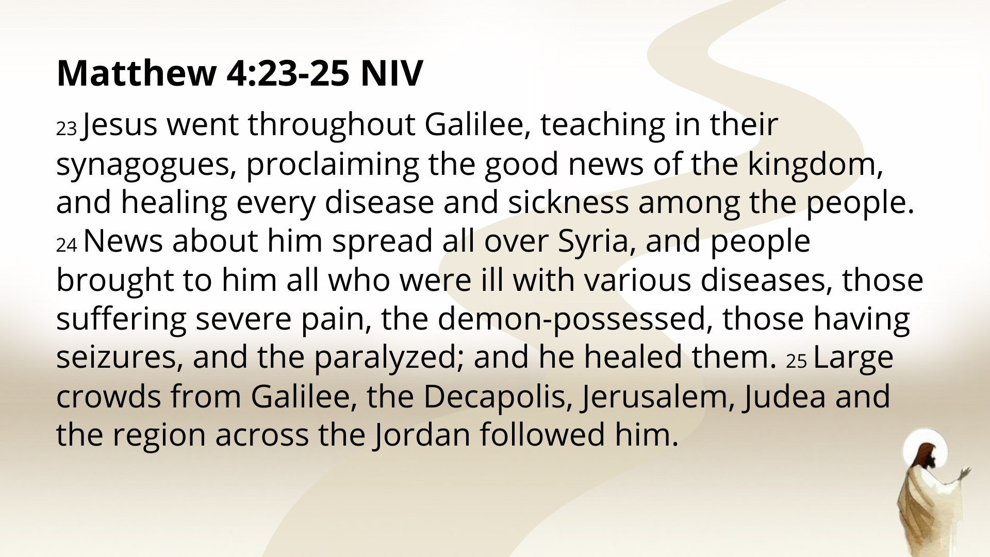
Notes:
[READ PASSAGE & COMMENT]
This is a description of the crowd that will gather for the Sermon on the Mount
And notice, this includes Gentiles (non-Jews), the poor, the sick, the marginalized & oppressed; it no doubt includes people working hard to make ends meet but can’t; and those suffering from physical illnesses and ailments, as well as those under demonic control. From what we’re told, this crowd is made up of common folks who have no power and are wanting a better life than what Rome has to offer them.
And so, the crowds (interested in the “good news” of Jesus) followed Yeshua into the countryside and up a mountain to hear the Lord begin his teaching by inviting them into… [NEXT SLIDE]

Slide 6
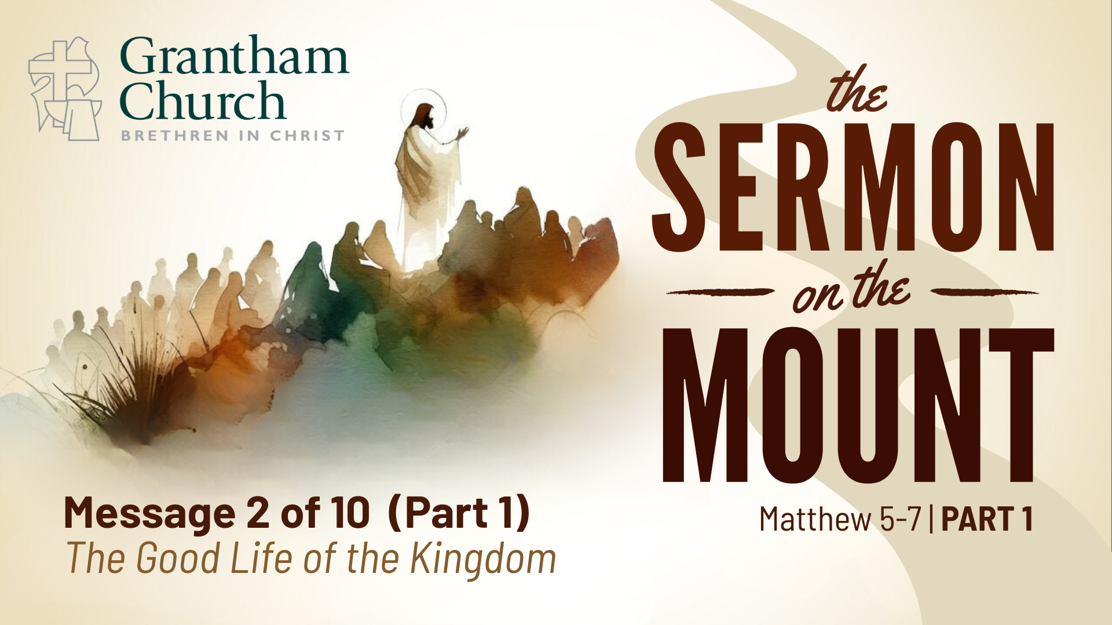
Notes:
The Good Life of the Kingdom.
Let’s turn now in our Bibles to the Gospel of Matthew, chapter 5… [NEXT SLIDE]

Slide 7
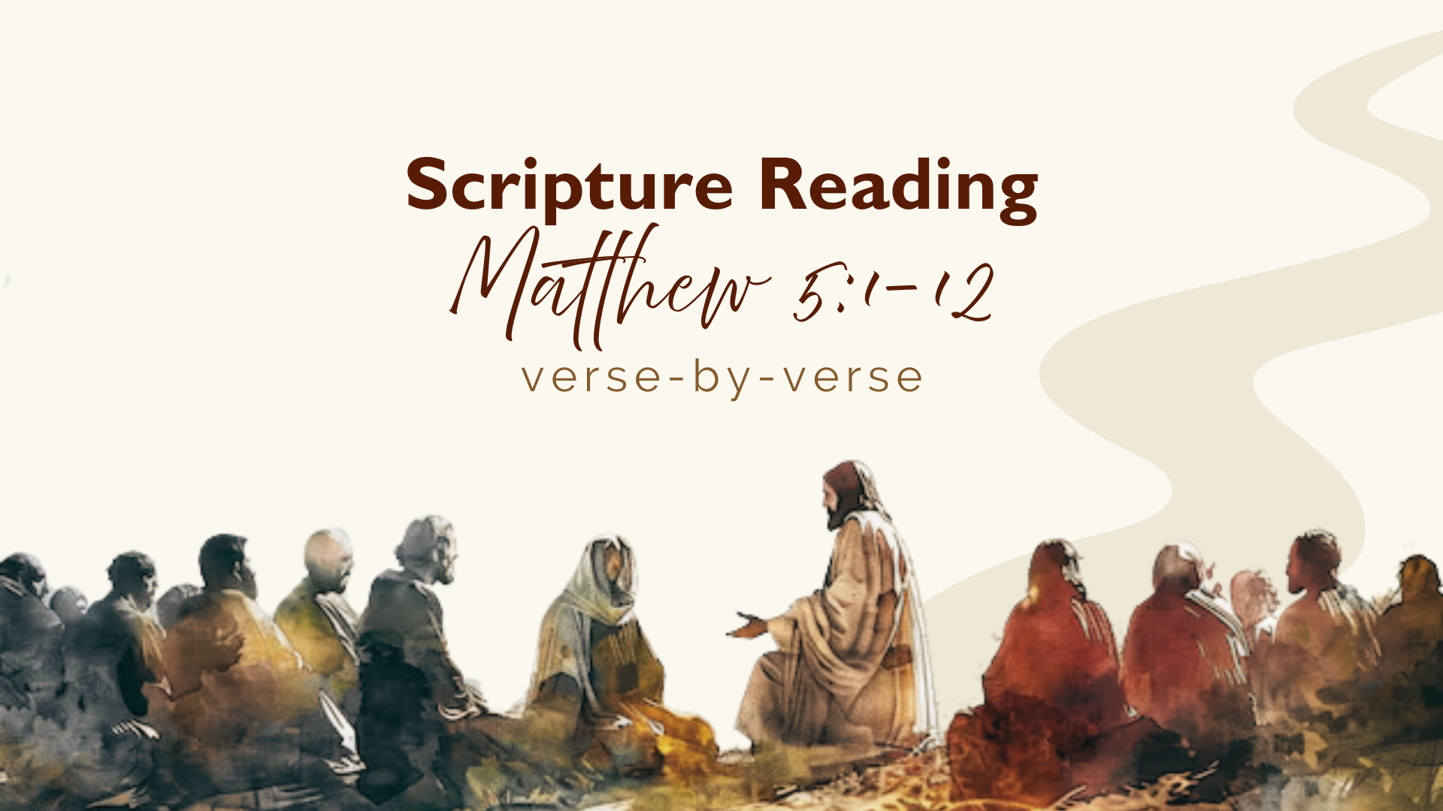
Notes:
[READ VERSE-BY-VERSE]
vs. 1-2 – It’s important to notice, from his birth story onward, Matthew wants us to see Jesus like Moses, but better than Moses. They both had dreams connected with their births, the slaughter of children is connected to their births, both barely escaped the clutches of evil kings, both had to flee and had to return when it was safe. And like Moses, Jesus was in the wilderness (Moses for 40 years, Jesus for 40 days), they both fasted and were tested, and “went up a mountain” to then deliver the law of God. And so, as Jesus will say later on, “I didn’t come to abolish the Law (Torah), but to fulfill it.” Therefore, Jesus is being presented here as the Teacher—teaching the new law as the new Moses for the new people of God. This is why Jesus preaches from a mountain.
And here is a picture of… [NEXT SLIDE]

Slide 8
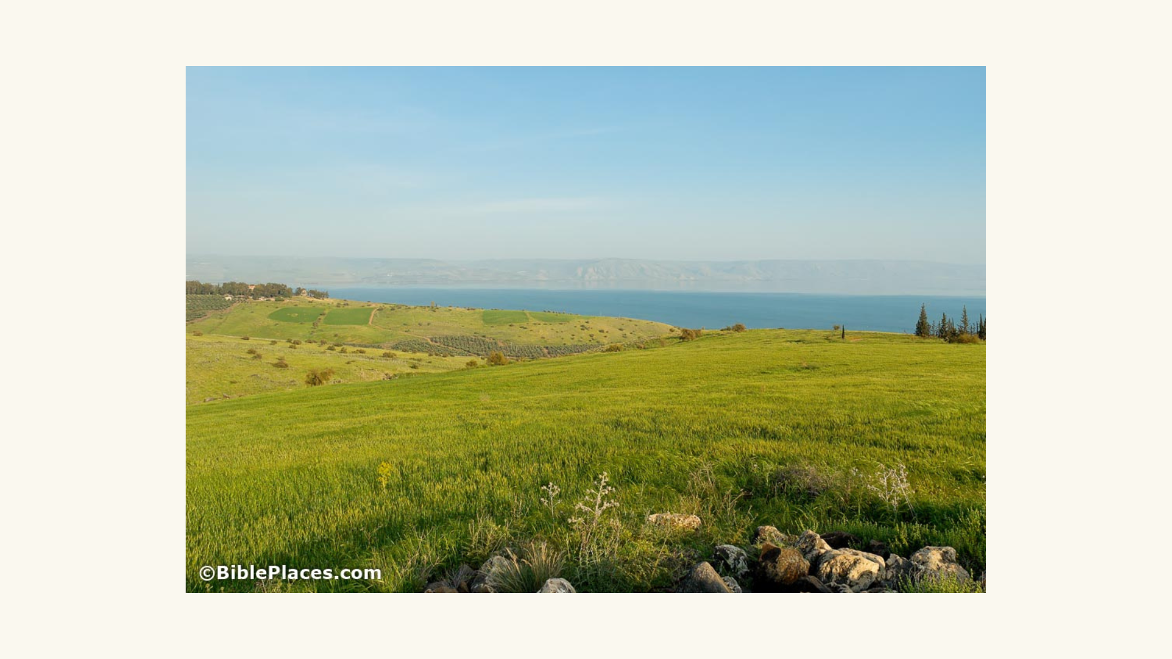
Notes:
The Mount of Beatitudes, a hill in northern Israel overlooking the Sea of Galilee, that is believed to be the place where Jesus spoke to his disciples and the crowds. You can just imagine the hillside covered with people listening in as Jesus teaches his disciples.
And the Lord begins his message with a series of blessings (9 to be exact), commonly referred to as The Beatitudes, which means “blessings” in Latin. And before we begin reading them with verse 3, do understand that a 9-week series could be done on the Beatitudes alone, but I’ll just be saying a few things about each of them today. So, I would encourage you to spend some time this week meditating on them further and checking out the resources I’ll include with the sermon at our website, podcast, and in the weekly email.
Also, as we begin reading, pay attention to the 3 sets of 3 in these blessings (i.e., vs. 3-5, 6-8 & 9-12). Each set of verses go together, as will become clear as we go verse-by-verse.
OK. Jesus begins the Sermon on the Mount in verse 3… [NEXT SLIDE]

Slide 9
Notes:
[READ VERSE-BY-VERSE & COMMENT]
What does “blessed” mean? Greek: makarios; Two words in Hebrew: baruch and ashrei; While baruch implies an active blessing from above, ashrei focuses more on the fortunate state of a person's life; Tim Mackie at the BibleProject believes the Hebrew word ashrei is more of what Jesus has in mind, which means “blessed” should be translated as “the good life.”
v. 3 – The good life belongs to the “poor in spirit” – the “spirit” is our life energy; our life energy (our vitality) is lacking; another words, you are powerless; you are without the power to do what needs to be done (e.g., spiritually, emotionally, politically, or economically). Jesus is saying, “The good life belongs to the powerless, for the Kingdom is yours!”
v. 4 – The good life belongs to those who “mourn” or “grieve” (an ongoing state of grief)– this is the same word used in Gen. 37 describing Jacob grieving over the loss of Joseph; he refused to be comforted; But Jesus says those who continually grieve (grieve for their powerlessness, grieve over injustices, and over losses) will be comforted, in this life, and certainly in the next; a willingness to grieve leads to the Kingdom; as one person said, “Grief is the price we pay for love.” And so, Jesus is saying, “The good life belongs to those who continually grieve for all that’s wrong in this world, for I will comfort you.”
v. 5 – “the meek” or “lowly” – meaning humble, referring here to those lower in social status, outcasts, or the unimportant and vulnerable; there are not the people you would expect to own land or wealth, by no means; and so, Jesus is saying, “The good life belongs to the unimportant and vulnerable, for you will be the wealthy managers of the earth.”
Clearly, Jesus has in mind Psalm 37:7-11 – “Be still before the Lord and wait patiently for him; do not fret when people succeed in their ways, when they carry out their wicked schemes. Refrain from anger and turn from wrath; do not fret—it leads only to evil. For those who are evil will be destroyed, but those who hope in the Lord will inherit the land. A little while, and the wicked will be no more; though you look for them, they will not be found. But the meek will inherit the land and enjoy peace and prosperity.”
Onto the second set of the three sets of blessings. Verse 6… [NEXT SLIDE]

Slide 10
Notes:
v. 6 – “hunger and thirst for righteousness” – this refers to a perpetual hunger and thirst (always hungry and thirsty) for “righteousness”; the root of righteousness means to be in right relationship with God and others, with a strong connection to justice and fairness; So, if you’re always hungry and thirsty for it, you are obviously seeing that it’s lacking; Jesus is saying, “The good life belongs to those who are always longing for a right relationship with God and others, for you (despite feeling empty) will be satisfied.”
v. 7 – “the merciful” – notice this follows “righteousness” (justice) in verse 6; the word carries with it ideas of forgiving a debt or someone who has wronged you or owes you something; friends, a world without mercy is a hellscape; and Jesus is calling his followers to lead the way in showing mercy, as he did in his own life; As the South African Bishop Desmond Tutu once said, “There is no future for the human race without forgiveness.” And so, Jesus is saying, “The good life belongs to those who show generous grace, compassion, and forgiveness (mercy), for the same will be shown to you.”
v. 8 – “the pure in heart” – yes, our behavior should be right by God and by others, but it’s also about our motivations and intentions; the “heart” is the home of our emotions and the center of our devotion; notice, Jesus is now going beneath the smiles and pleasantries, to your thoughts, feelings, and loves. Remember what Psalm 24:3-5 says, “Who may ascend the mountain of the Lord? Who may stand in his holy place? The one who has clean hands and a pure heart, who does not trust in an idol or swear by a false god. They will receive blessing from the Lord and vindication from God their Savior.” Therefore, Jesus is saying, “The good life belongs to those who are fully devoted to God, for they are the ones who will know and experience who God really is.”
And now the final set of blessings. Verse 9… [NEXT SLIDE]

Slide 11
Notes:
v. 9 – “the peacemakers” – not peace-keepers, but peace-makers; and making peace won’t always be peaceful; in fact, it may look like trouble-making; it did for Jesus; so, peacemaking isn’t avoiding conflict, it’s about entering in to deescalate it by representing the Prince of Peace, helping to turn something ugly into something beautiful; Jesus shows us that peace has to be made, and he wants his followers to be the ones who make it in his way. How do we do that? Well, keep listening to the sermon! And this is quite subversive, because all of this is being said in the context of a fractured Israel. But… “The good life belongs to those who make peace, for they reveal themselves to be the true children of God.”
v. 10 – “those persecuted for righteousness” – if you’re going to enter into conflict, confront evil and injustice, if you’re going to live out the Jesus way, then know that you’re going to get caught in the crossfire of the extremes (third way); Jesus says you can expect that you’ll be made fun of, called names, misunderstood, and maligned. But at the very least, you and God will know what’s what. And you will not be alone. That is why Jesus says, “The good life belongs to those who are mistreated because of seeking to live in right relationship with God, neighbors, and enemies, for the Kingdom of heaven is yours!”
And the last beatitude, which comes as an added blessing for suffering…
v. 11 – 12 – What does Jesus mean? He is reframing our experience of suffering; if we are identifying ourselves with Christ and living out his good news of the Kingdom, we will at some point come up against opposition; we will be challenged, opposed, accused, insulted, defamed, hated, and even persecuted (in violent speech or action) for walking the narrow path of Jesus—for seeking to follow the Way to the good life of the Kingdom of heaven. But we can celebrate because we’re not alone (many have gone before us) and this struggle and suffering will be rewarded in the life to come.
Therefore, brothers and sisters, we need to wake up to the competing visions of the good life. For just as Romans had their idea of the good life, so does American society and culture. And I submit to you that, generally speaking, it is at odds with Jesus’ Kingdom vision. Let’s consider that as we seek to apply what we’ve heard from Jesus to our lives… [NEXT SLIDE]

Slide 12
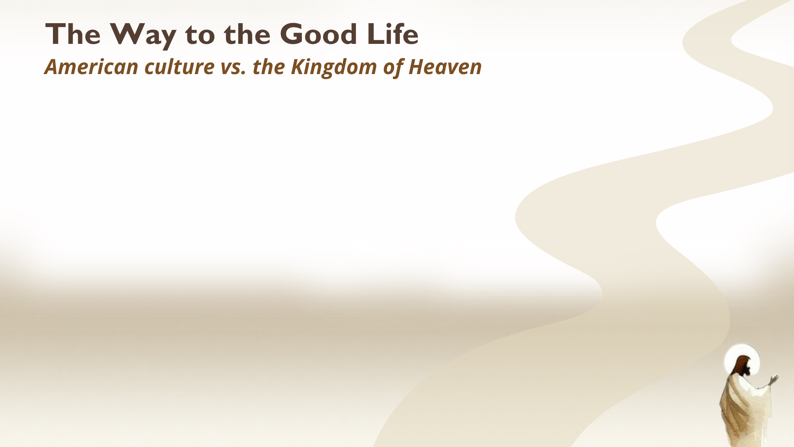

Slide 13
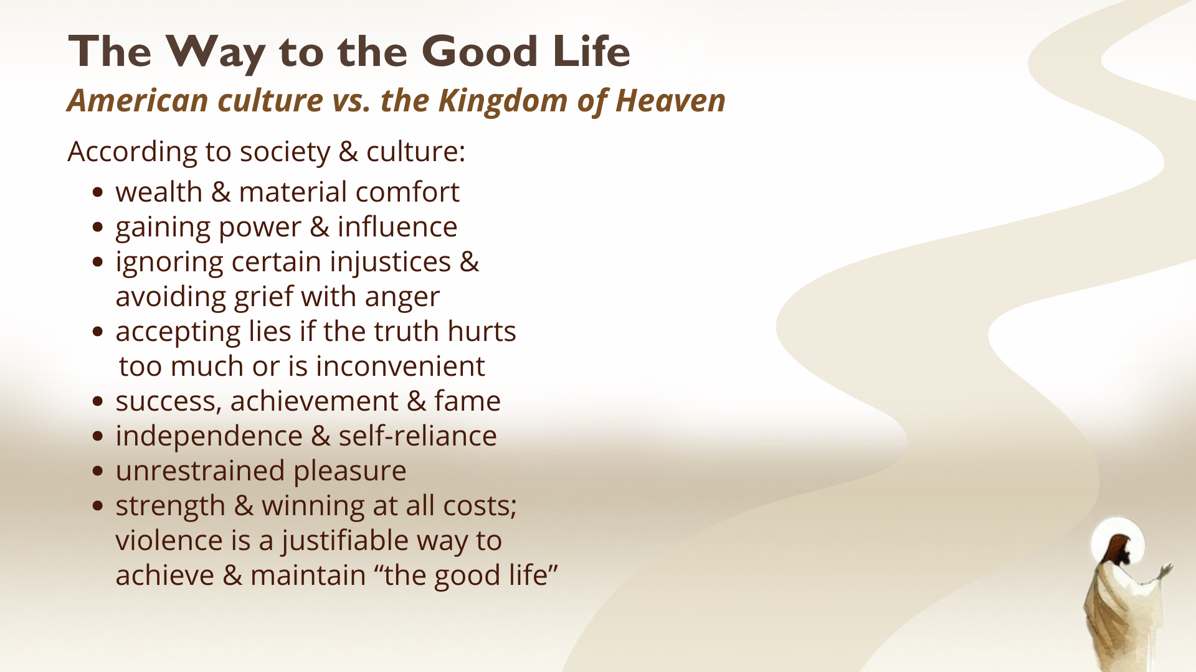
Notes:
[READ & COMMENT ON EACH POINT]
To sum it up, the American vision says: “The good life is found in self-promotion, self-reliance, comfort, and success.” It’s true… the Founding Fathers, with their knowledge of history, law, philosophy, and yes, the Bible, had some of the best ideas ever imagined for a nation. As the declaration of independence states: “We hold these truths to be self-evident, that all men are created equal, that they are endowed by their Creator with certain inalienable Rights, that among these are Life, Liberty and the pursuit of Happiness.” Folks, that’s pretty good.
But who is the Creator? What is he like? And what does he require of us? And what is life, liberty and the pursuit of “the good life” without Jesus Christ defining it for us? I’ll tell you what it is… it’s what we’ve made it. We’ve seen it this week, haven’t we? Because as good and noble as the founding ideas may have been, America is still a worldly kingdom, marred by sin, death, violence, and oppression. And so, we must accept that the American empire and her society and culture cannot produce the good life of the Kingdom of heaven.
Only Jesus can give that to us and show us the way… [NEXT SLIDE]

Slide 14
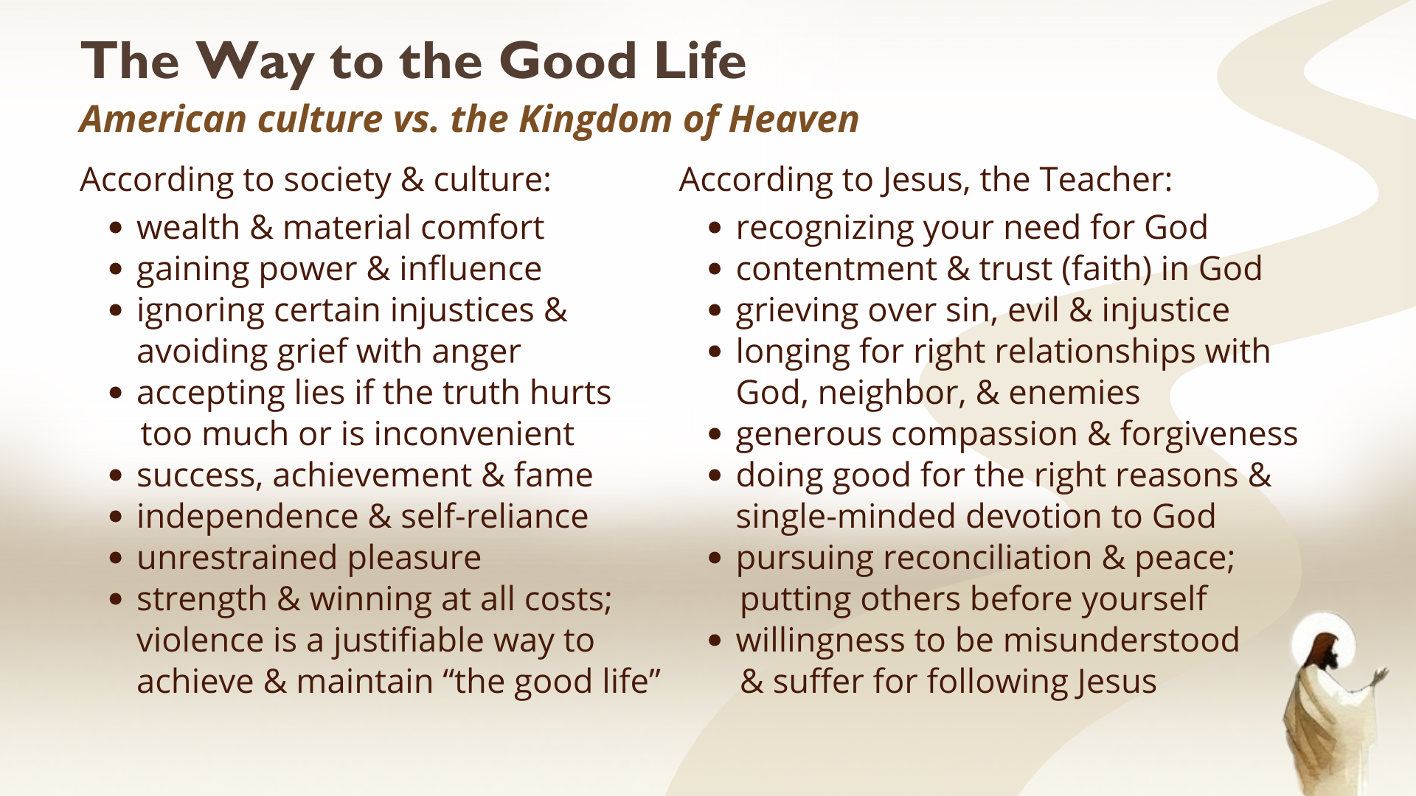
Notes:
[READ & COMMENT ON EACH POINT]
And so, Jesus’ vision says: “The good life is found in self-denial, dependence on God, mercy, and sacrificial love—even when it costs you.” My friends, we’re being invited to see that Jesus’ teaching reveals a complete reversal of our value system. Are we prepared to repent of that value system for “the good life” that Jesus offers us?
We can do it, but for us to fully accept, embrace, and embody Jesus’ way to the good life, we must adopt an eternal perspective. You see, church, we can let go of these things because this life is not all there is; there is more to come. Jesus said that the world as we know it will pass away, but his words will never pass away. His Kingdom… it’s coming. Which is why we can afford to sacrifice and suffer for following Jesus into a greater righteousness.
Finally, here are some questions to help us reflect and respond together… [NEXT SLIDE]

Slide 15
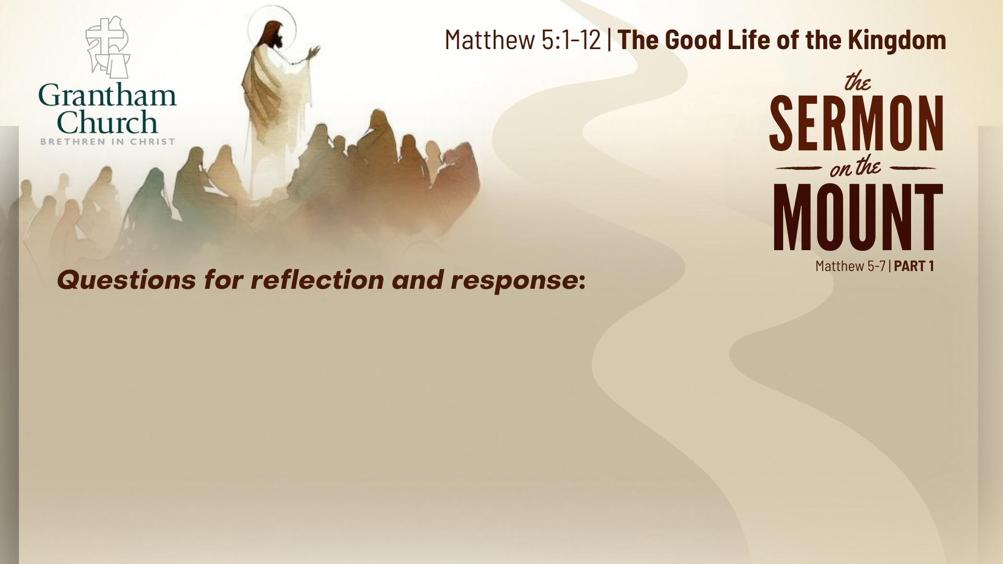

Slide 16
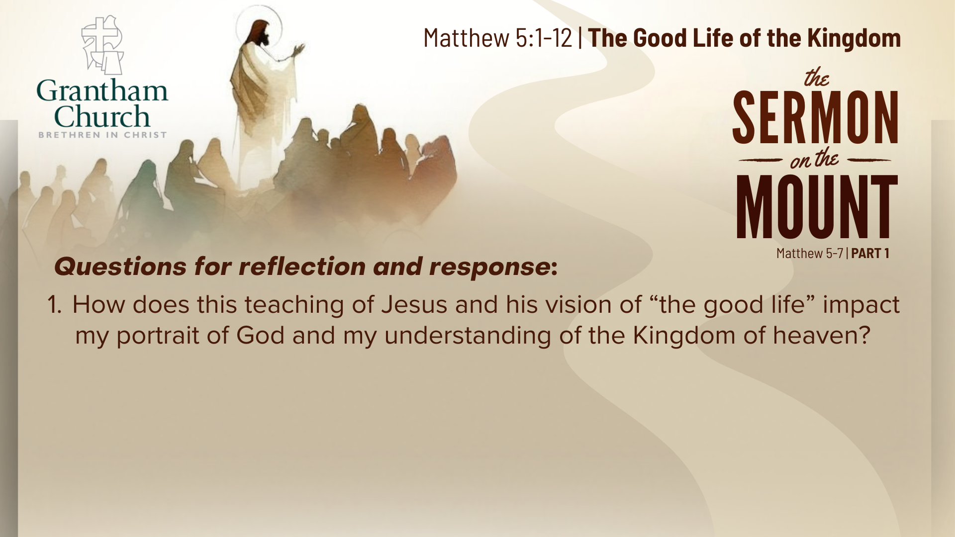

Slide 17
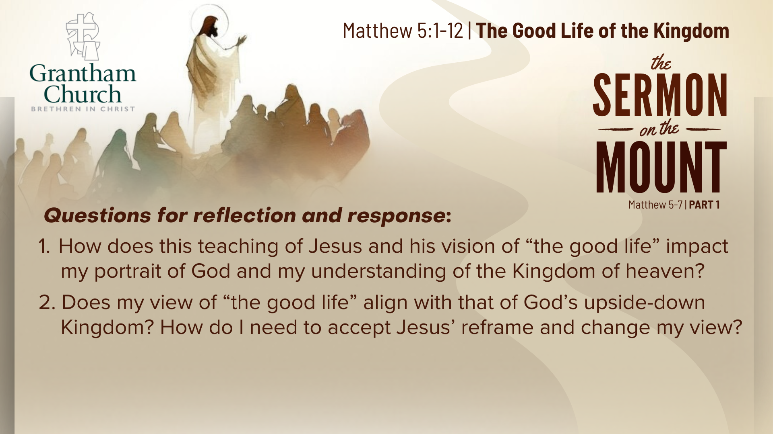

Slide 18
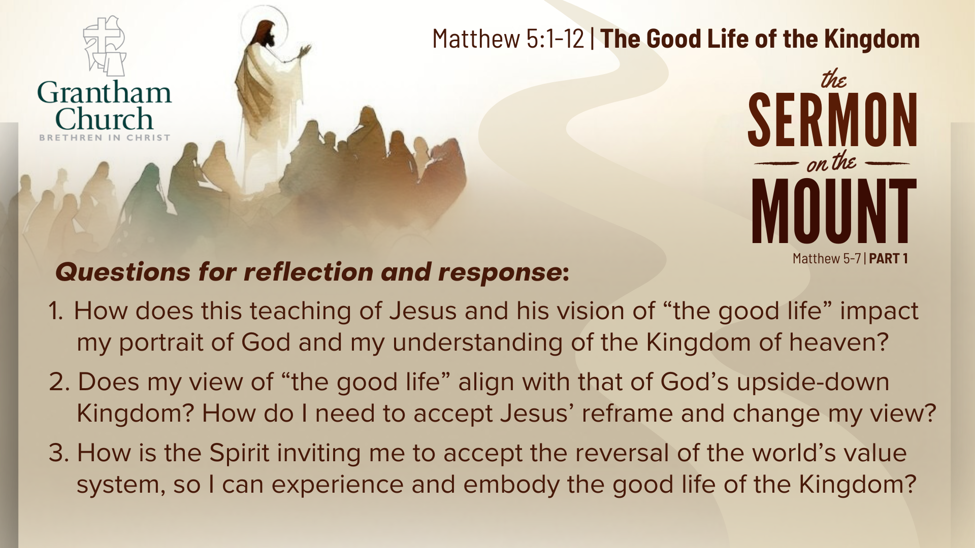
Notes:
[READ & BRIEF COMMENT ON EACH QUESTION]
How does this teaching of Jesus and his vision of “the good life” impact my portrait of God and my understanding of the Kingdom of heaven?
Does my view of “the good life” align with that of God’s upside-down Kingdom? How do I need to accept Jesus’ reframe and change my view?
How is the Spirit inviting me to accept the reversal of the world’s value system, so I can experience and embody the good life of the Kingdom?
[CLOSING WORDS]
Let’s pray… [NEXT SLIDE FOR CLOSING PRAYER]

Slide 19
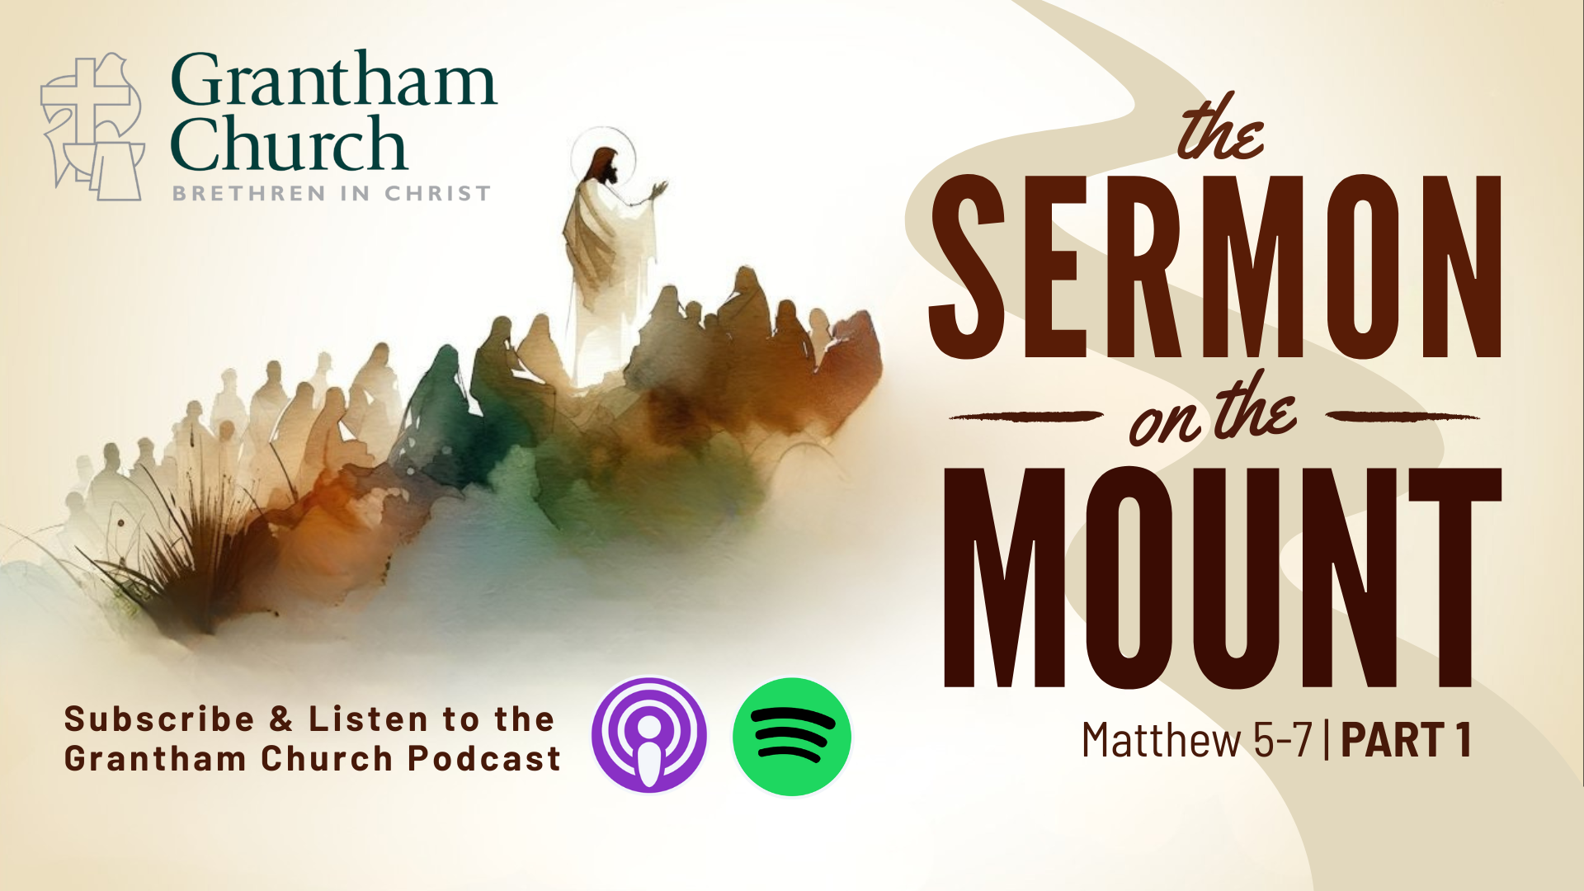
Notes:
[CLOSING PRAYER]
[CLOSING SONG]
[ANNOUNCEMENT]
Benediction
Brothers and sisters, you have heard the words of Jesus and the call to follow him. The path is narrow, but it leads to life. Remember that Christ walks with you, the Father surrounds you, and the Spirit empowers you. Therefore, go in peace, to love and serve the Lord. Amen.

